Slide 1

Speak fluently
Intermediate

Slide 2
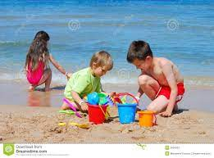
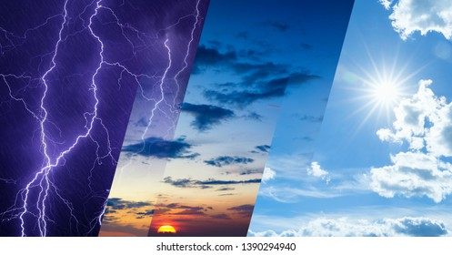
7. The Weather

Slide 3
7. The Weather
Don’t you think weather has changed a lot because of global warming? Can you describe there changes?
What do you think the weather will be like in your country 100 years from now?
What is something that is EASIER to do in winter?
What is something that is HARDER to do in the summer?
What comes to mind when you hear the word ‘weather’?
What is your favorite weather?
What do you think of today’s weather?
Do you worry about the world’s changing weather?
Why do different countries have different weather?
Has the weather in your country changed over the past decades?
Have you ever experienced extreme weather?
What are your favourite weather words?
Do you understand all the symbols on the weather map?
How does the weather change you feelings?
When was the last time the weather destroyed one of your plans?

Slide 4
7. The Weather
1. What kind of weather do you like? ?
2. Does the weather affect your mood?
3. Have you ever been stuck in traffic because of bad weather?
4. Which do you like better hot weather or cold weather?
5.What things about summer do you like most and least?
6.Did you have a good summer this year?
4.What do you like doing in summer that you can’t do at other times of the year?
5. .Do you change your habits in winter? What do you like doing in winter that you can’t do at other times of the year?
6.When you think of Fall ( Autumn) what words or images pop into your mind?
7. What would you change about Spring in our country?
8. What memories of winter/ summer time from your childhood do you have?
9. .How do you feel when spring arrives?
10. How well do you sleep in winter?

Slide 5
7. The Weather
10. Do you think winter/ summer feels differently to people of different ages?
11. What are the usual “summer vacation” activities, such as camps, sports, family vacations, etc. and extraordinary activities?
12. What kind of summer holiday do you prefer: seaside, lake, mountain, cruise, camping, fishing, city break, cultural break, adventure, desert, jungle, safari, etc.? Have you ever been on this kind of holiday? What did you think of it? Are there any that you would never try? Why not?
13. Do you prefer to stay in your own country or go abroad in summer? Why?
16. How hot is too hot for you? When was the hottest / coldest summer you can remember? Is summer weather changing for better or worse? Is climate change having an effect?
14. What summer period can we call dog days in Egypt? How does it affect you?
15. Do you prefer beaches or swimming pools in summer?
16. Describe the difference between summer and winter in Egypt.
17. How do you keep cool on hot summer days?
18. Do you like summer?

Slide 6
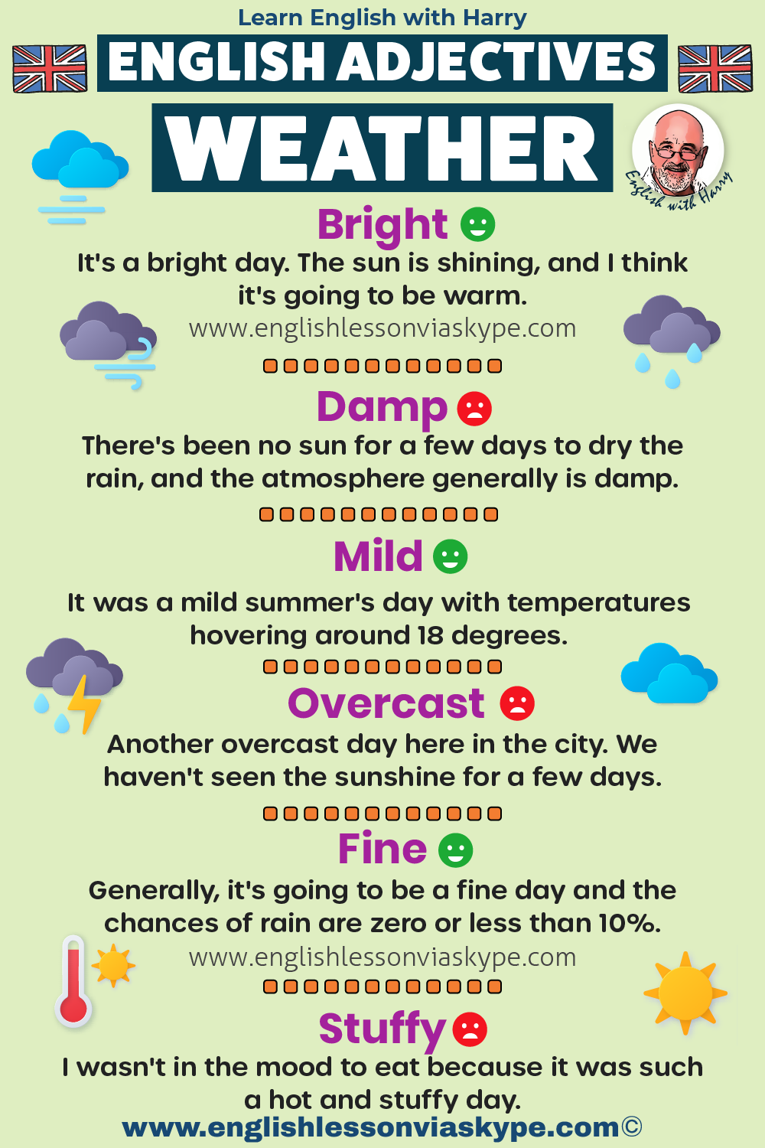
7. The Weather

Slide 7
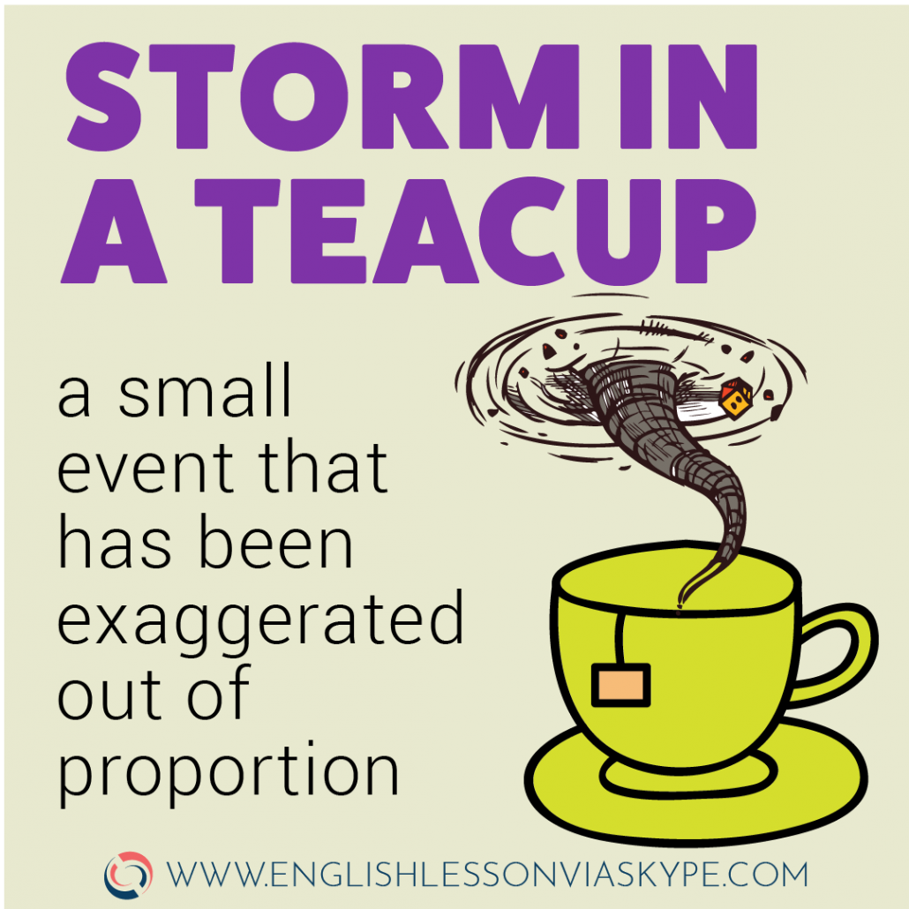
7. The Weather

Slide 8
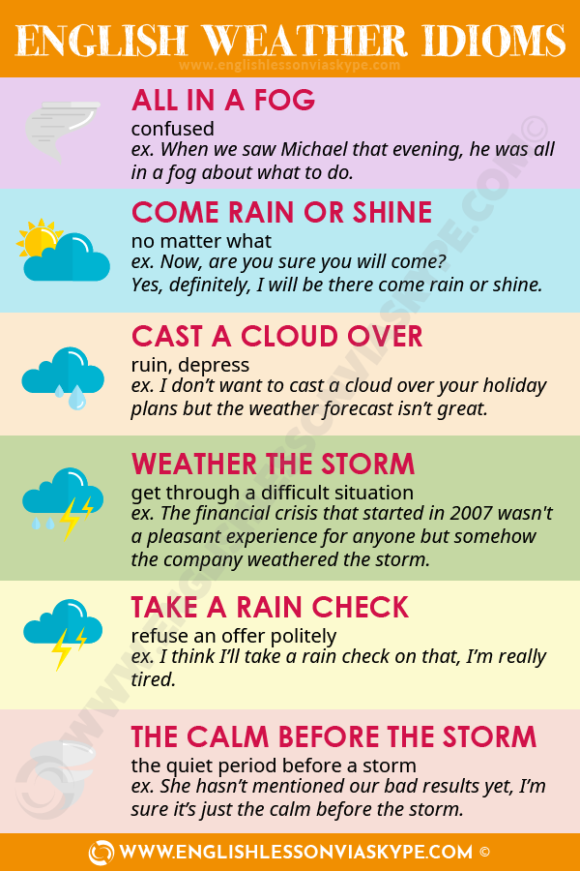
7. The Weather

Slide 9
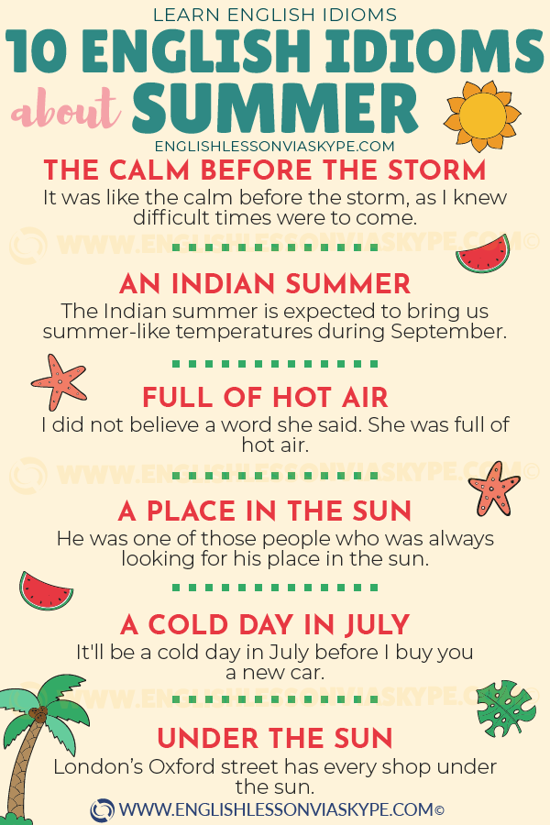
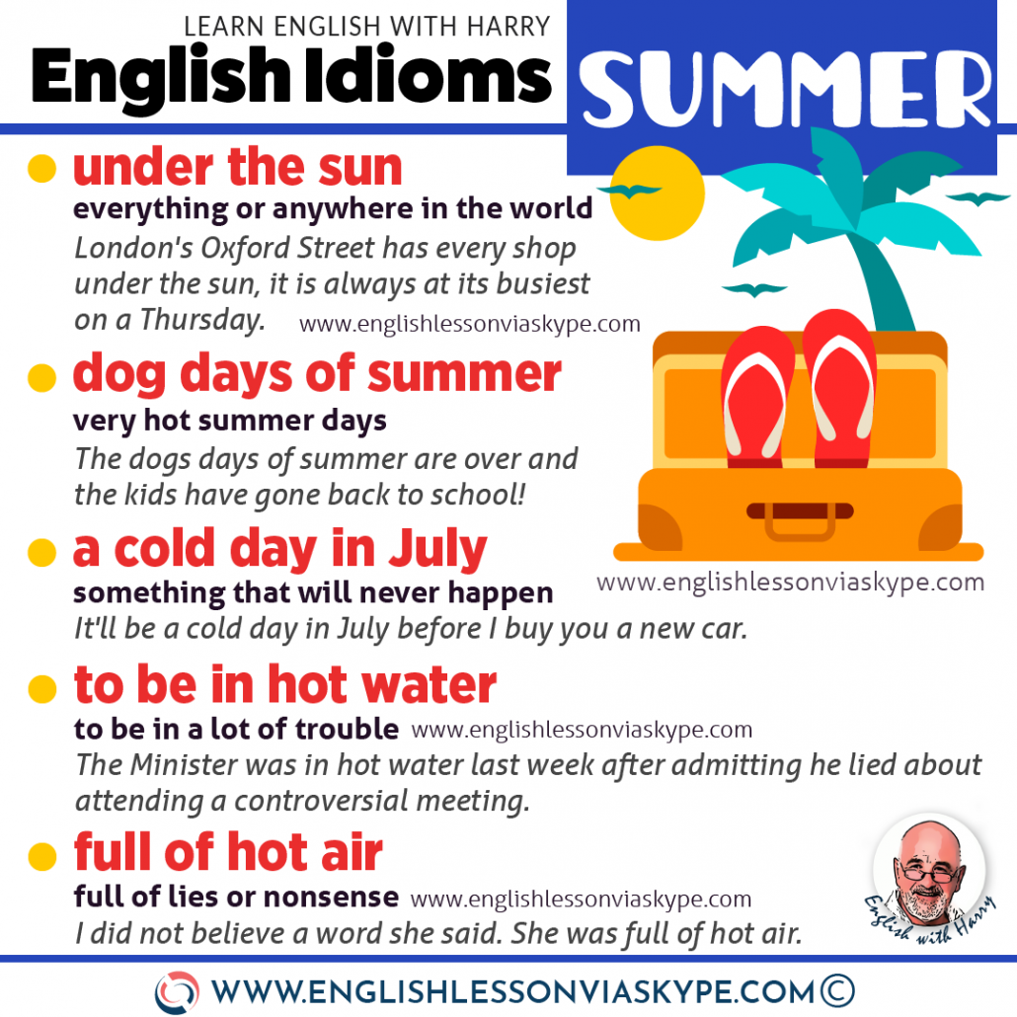
7. The Weather

Slide 10
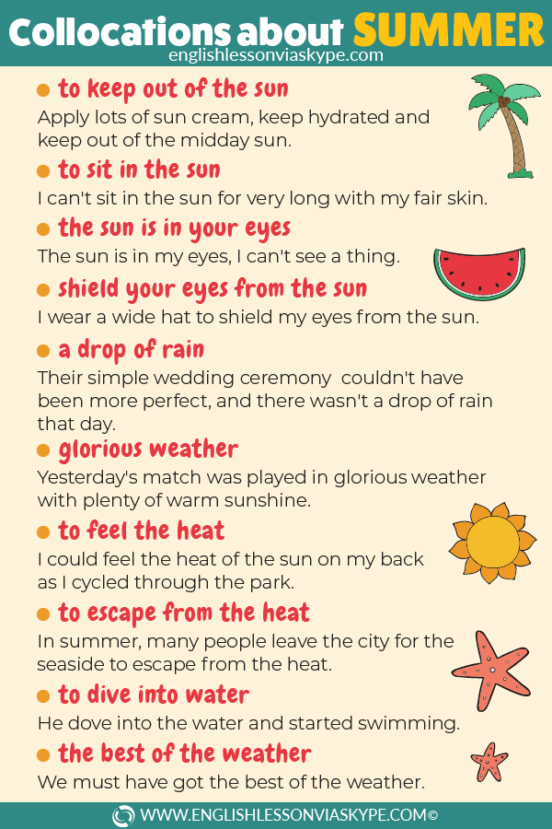
7. The Weather

Slide 11
7. The Weather
Summer Vocabulary
Siesta
not really an English word but used frequently. Particularly relevant in the summer when a quick “nap” or “forty winks” in the afternoon is just what you need to be ready for a long summer evening.
Nap and forty winks refer to a quick sleep or rest.
A Quick Dip
If you are feeling a little hot and need to refresh a swim is often a good idea. A quick dip refers to a jump into a pool, river or sea to refresh yourself.
Top Up The Tan
Everyone likes to look good and when the sun shines we can get that “good feeling” with a sun tan. People like to catch the sun rays on a regular basis over the summer to keep the tan looking well naturally.
Twenty minutes in the sun a few times a week may just be enough to top up that tan!
The Bucket And Spade
No holiday for the kids was complete without their traditional bucket and spade. These simple tools keep children of all ages occupied for hours on the beaches in any type of weather. Building sand castles and other impressive constructions with the help of Dad (or Mum) of course is a great diversion for all the family.

Slide 12
To Cloud Over
Meaning: when the sky begins, and eventually, gets covered in grey clouds, whether light-grey or dark-grey.
So we can wake up and say:
So the day started brightly with sunshine and blue sky. As the day progressed it clouded over.
Meaning the clouds covered the sky.
To Start Off/Out
Meaning: to begin
The day started off bright but, as the day progressed, it changed.
Or
The day started off quite brightly but around lunch time it clouded over.
So I can include both of those phrasal verbs in that particular sentence.
The day started out quite brightly but, as the day progressed, it got gradually worse.
To Pour Down
Meaning: to rain exceptionally heavily, as if it’s poured out of a glass
The rain was pouring down.
It was pouring down with rain.

Slide 13
To Bucket Down
Meaning: to rain heavily, more informal than TO POUR DOWN
Yesterday it bucketed down.
Finally, some weather phrasal verbs with a little brighter outlook.
To Brighten Up
Meaning: to improve, the sky will become lighter
Example:
The day brightened up as we got near to tea time.
To Clear Up
Meaning: to become brighter, to improve, it will stop being rainy or cloudy
The day began to clear up around noon.
To Pick Up
Meaning: to get better gradually
Example:
– The weather is not so good at the moment. Do you think the day would pick up?
– I think it will pick up later on.
We can also use TO PICK UP if we’re talking about wind speeds.
Winds will pick up later in the afternoon, becoming strong by the evening.
Meaning: wind speed will increase, winds will become stronger.
To Die Out
Meaning: to slowly disappear and stop completely
Example:
Today we have very strong winds and that has brought a lot of heavy rain but by later afternoon these winds and the heavy rain will begin to die out.
To Let Up
Meaning: to stop or improve
Example:
The weather recently has been freezing cold but the weather forecast says it will let up by the weekend.

